Slide 1
Credit Card Fraud
Detection
By
Akshay Mukundwar

Slide 2
Introduction
What is Credit Card Fraud?
Fraudster steals your credit card number.
Fraudster buys an expensive item online using your card.
Fraudster resells this items.
You see a high-value transaction you never authorized on your credit card statement.
You initiate a dispute for this transaction with your bank.

Slide 3
Problem statement
The credit card has increasingly become the most accepted payment mode for both offline and online transactions in today’s world.
Hence risk of fraudulent transactions using credit card has also been increasing.
So the Credit Card Fraud Detection Problem includes modeling past credit card transactions with the knowledge of the ones that turned out to be fraud.

Slide 4
Objective
Objective is to build a model such that it will then be used to identify whether a new transaction is fraudulent or not. My aim here is to detect 100% of the fraudulent transactions while minimizing the incorrect fraud classifications.

Slide 5
Approach
Performing some EDA on the dataset.
Using resampling methods to balance the class as the class in highly imbalance
Building a model
Evaluating model based on ROC, Precision and Recall.

Slide 6
Dataset Details
The datasets contains transactions made by credit cards in September 2013 by european cardholders.
The data set is highly skewed, consisting of 492 frauds in a total of 284,807 observations. This resulted in only 0.172% fraud cases. This skewed set is justified by the low number of fraudulent transactions.
The dataset consists of numerical values from the 28 ‘Principal Component Analysis (PCA)’ transformed features, namely V1 to V28. Furthermore, there is no metadata about the original features provided, so pre-analysis or feature study could not be done.

Slide 7
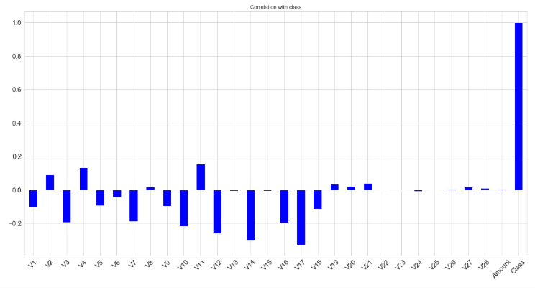
Correlation of Columns with class

Slide 8
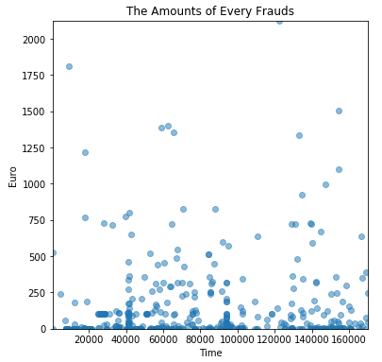
Amount and Time of Fraud

Slide 9
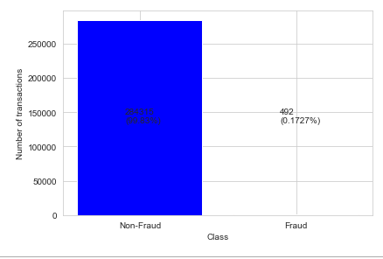
Class Details
Class is highly imbalanced as it can be seen in the plot below :
The number of normal transactions : 284315
The number of frauds : 492
The percentage of fraud of all transactions : 0.172

Slide 10
Balancing the Class
Before balancing I have split the data in train and test to set some observations aside to be used as a test set.
There are several ways to approach the unbalance class, like resampling the Dataset using undersampling, oversampling or SMOTE
Here I have used SMOTE(Synthetic Minority Oversampling Technique)to handle class imbalance

Slide 11
Why SMOTE ?
The drawback of using Undersampling is that we are removing information that may be valuable. This could lead to underfitting and poor generalization to the test set.
The drawback of using Oversampling method is that, since oversampling simply adds replicated observations in original data set, it ends up adding multiple observations of several types, thus leading to overfitting.
Where as SMOTE instead of replicating and adding the observations from the minority class, it overcome imbalances by generating artificial data. It is also a type of oversampling technique.SMOTE uses a nearest neighbors algorithm to generate new and synthetic data we can use for training our model.

Slide 12
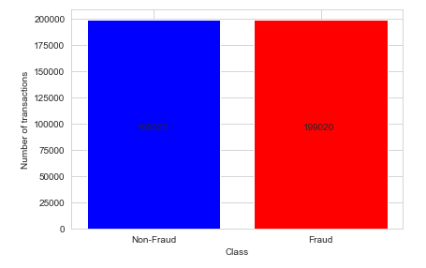
Class after SMOTE

Slide 13
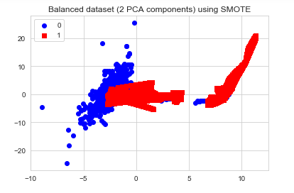
Visualization of data in 2D

Slide 14
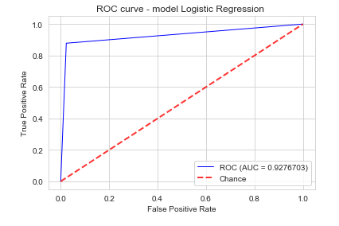
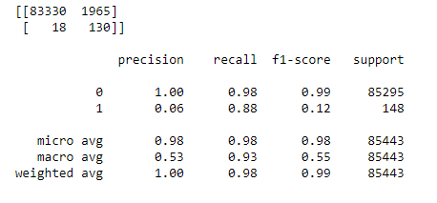
Model Building
Logistic Regression

Slide 15
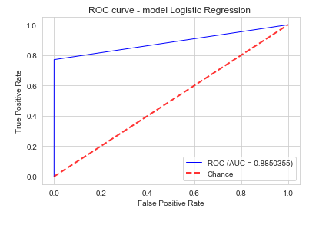
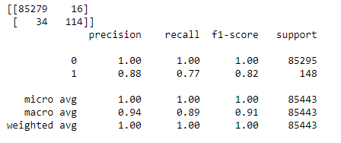
Model Building
2 . Random Forest

Slide 16
Thank You !!!

